Slide 1

X33fcon 2023 Cat & Mouse – or chess?
Fabian Mosch

Slide 2

Agenda
00
X33fcon 2023 – Cat & Mouse – or chess?

Slide 3


Agenda
X33fcon 2023 – Cat & Mouse – or chess?
Whoami
How EDRs detect malicious Payloads
Published userland hooking bypass techniques
The idea for a new approach
Challenges in the implementation
The Proof of Concept

Slide 4
Whoami
01
X33fcon 2023 – Cat & Mouse – or chess?

Slide 5

Whoami
X33fcon 2023 – Cat & Mouse – or chess?
Teamleader Pentest/Red-Team @r-tec
Breaking into company environments at work & escalating privileges
Inspired by the community, likes to share knowledge
Publishing Tools/Scripts on Github, Blogposts, YouTube-Videos
Special interest in AV/EDR Evasion topics

Slide 6
How EDR‘s detect malicious Payloads
02
X33fcon 2023 – Cat & Mouse – or chess?

Slide 7
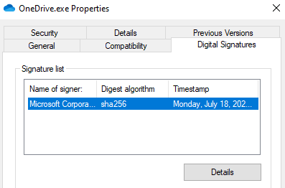
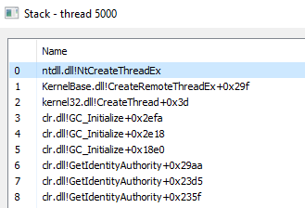
How EDR’s detect Malicious Payloads
X33fcon 2023 – Cat & Mouse – or chess?
User Land:
Static & Dynamic Analysis
Userland-Hooking
Stack Trace Analysis
Kernel Land:
Kernel Callbacks
ETW Threat Intelligence (ETWti)

Slide 8
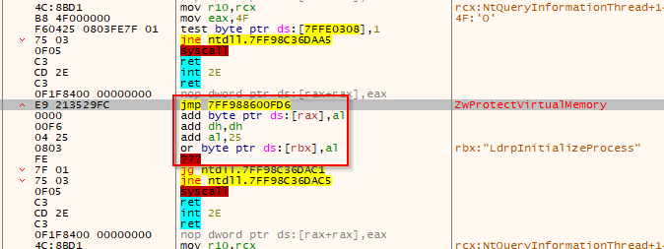
How EDR’s detect Malicious Payloads
X33fcon 2023 – Cat & Mouse – or chess?
Userland Hooks
Memory Windows API patching
The jmp goes to the EDR DLL
Input arguments analysis
Malicious Payloads can be detected on runtime

Slide 9
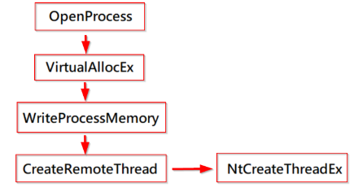
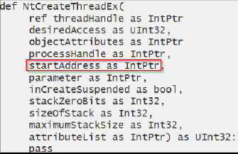
How EDR’s detect Malicious Payloads
X33fcon 2023 – Cat & Mouse – or chess?
Userland Hooks – simle Example
EDR checks the startAddress on runtime
A memory Scan for it’s memory location is done
Yara rule finds Cobaltstrike/Sliver/Covenant Shellcode and verifies that as known malicious
The Process is killed

Slide 10
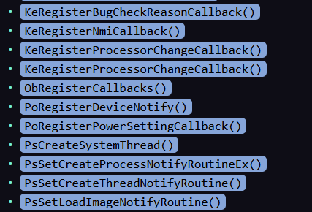
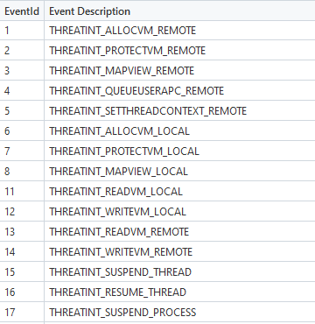
How EDR’s detect Malicious Payloads
X33fcon 2023 – Cat & Mouse – or chess?
Kernel Callbacks
Live interception / interaction
Imaginable like Hooks but from Kernel land
ETW threat intelligence
Event based subscriptions
Interaction after event capture
Stack Trace analysis
Memory Scans
Excerpt Kernel Callbacks1
Excerpt TI Provider events2
1 https://pre.empt.dev/posts/maelstrom-edr-kernel-callbacks-hooks-and-callstacks/#Kernel_Callbacks
2 https://posts.specterops.io/uncovering-windows-events-b4b9db7eac54
Notes:
Process Creation, Thread creation, Image loading, …
For several potentially malicious API Calls

Slide 11
Bypassing Userland Hooks
03
X33fcon 2023 – Cat & Mouse – or chess?

Slide 12
Bypassing Userland Hooks
X33fcon 2023 – Cat & Mouse – or chess?
Techniques with PoCs published in the last years:
Unhooking
Using Direct Syscalls
Using Hardware Breakpoints
DLL Entrypoint Patching

Slide 13
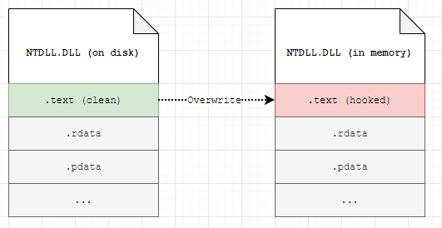
Bypassing Userland Hooks
X33fcon 2023 – Cat & Mouse – or chess?
Unhooking:
https://www.ired.team/offensive-security/defense-evasion/how-to-unhook-a-dll-using-c++
Notes:
Grabbing a fresh ntdll.dll copy from Disk, KnownDLLs, …
Search for the current Process ntdll.dll .text section
Overwrite that with the fresh DLLs .text section

Slide 14
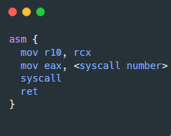
Bypassing Userland Hooks
X33fcon 2023 – Cat & Mouse – or chess?
Using Direct Syscalls:
Typically retrieved from:
Memory (HellsGate1, RecycledGate2,…)
Disk (GetSyscallStub – e.G. C# Dinvoke3)
(Partially) Embedded (Syswhispers 1 2 3)
1 https://github.com/am0nsec/HellsGate
2 https://github.com/thefLink/RecycledGate
3 https://github.com/TheWover/DInvoke
4 https://github.com/jthuraisamy/SysWhispers
5 https://github.com/jthuraisamy/SysWhispers2
6 https://github.com/klezVirus/SysWhispers3

Slide 15
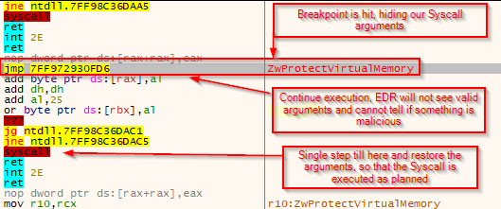
Bypassing Userland Hooks
X33fcon 2023 – Cat & Mouse – or chess?
Using Hardware Breakpoints – TamperingSyscalls21:
Set Hardware Breakpoints for the Syscall start address
1 https://github.com/rad9800/hwbp4mw/blob/main/TamperingSyscalls2.c

Slide 16
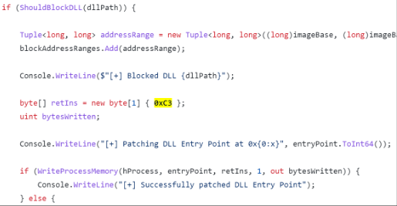
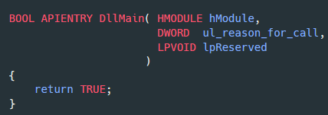
Bypassing Userland Hooks
X33fcon 2023 – Cat & Mouse – or chess?
DLL Entrypoint Patching – SharpBlock1:
Create a child Process with the DEBUG_ONLY_THIS_PROCESS2 flag
As Debugger, check for LOAD_DLL_DEBUG_EVENT events -> EDR DLL loading
Patching the DLLs entrypoint – it exits without creating hooks
1 https://ethicalchaos.dev/2020/06/14/lets-create-an-edr-and-bypass-it-part-2/
2 https://learn.microsoft.com/en-us/windows/win32/procthread/process-creation-flags

Slide 17
The Idea for a new approach
04
X33fcon 2023 – Cat & Mouse – or chess?

Slide 18
The IDEA for a new Approach
X33fcon 2023 – Cat & Mouse – or chess?
Inspiration: Alejandro Pinna - Bypass AMSI by hooking NtCreateSection1
We hook an API from the DLL loading process, e.G. NtCreateSection
Our hook checks for the target DLL being loaded
Return NTSTATUS fail
The target DLL cannot get mapped into memory
Initially used to bypass AMSI
Target DLL has to be not loaded yet
1 https://waawaa.github.io/es/amsi_bypass-hooking-NtCreateSection/

Slide 19
The Idea for a new Approach
X33fcon 2023 – Cat & Mouse – or chess?
The problem with AV/EDR DLLs
EDRs are like the white player in a Chess game1
They do the first move with hooks loaded directly via the kernel
For any userland Process
The EDR DLL is loaded directly after ntdll.dll
Hooks are set even before other DLLs like Kernel32.dll are loaded
1 https://bruteratel.com/release/2022/08/18/Release-Scandinavian-Defense/
Notes:
„In a good implementation this means”
Existing approach to get in control:
SharpBlock with debugging a child process

Slide 20
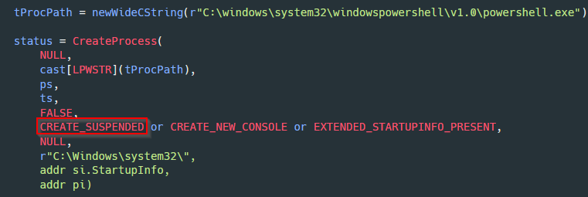
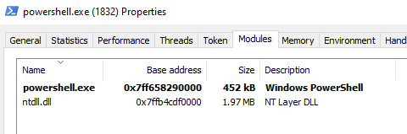
The Idea for a new Approach
X33fcon 2023 – Cat & Mouse – or chess?
The alternative:
Suspended processes only have ntdll.dll loaded

Slide 21
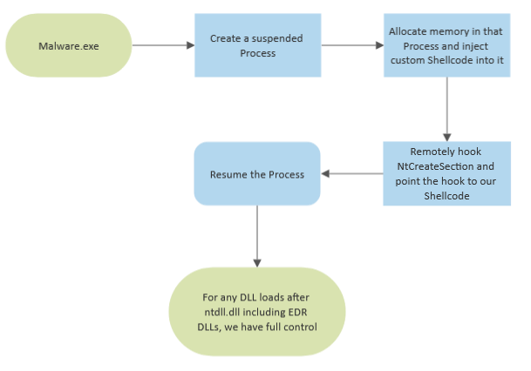
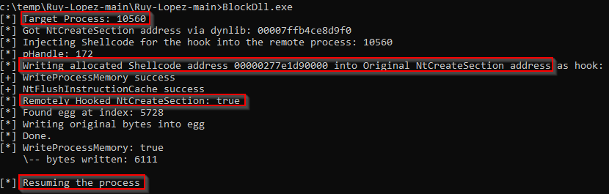
The Idea for a new Approach
X33fcon 2023 – Cat & Mouse – or chess?

Slide 22
Challenges in the Implementation
04
X33fcon 2023 – Cat & Mouse – or chess?

Slide 23
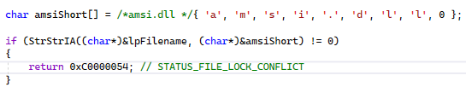
Challenges in the Implementation
X33fcon 2023 – Cat & Mouse – or chess?
Writing PIC Code
Everything should only exist in the .text section
No global Variables
Resolving APIs on Runtime
Replace mainCRTStartup with our entrypoint

Slide 24
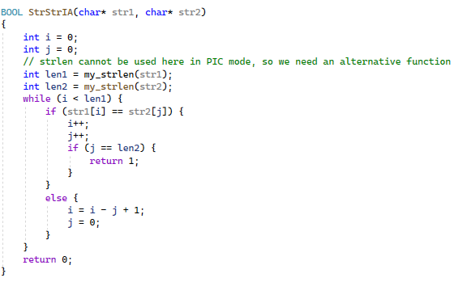
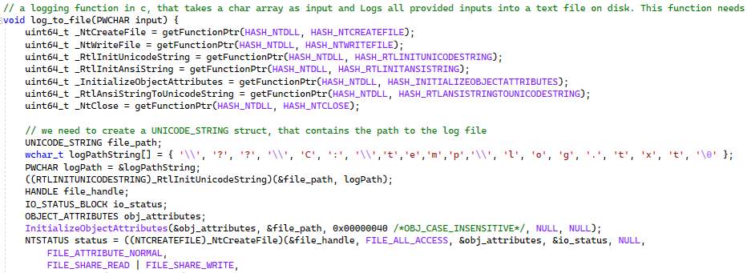
Challenges in the Implementation
X33fcon 2023 – Cat & Mouse – or chess?
Writing PIC Code
The code needs to use ntdll.dll functions exclusively
Many functions such as charcmp, StrStrIA, strlen, memcpy are not usable

Slide 25
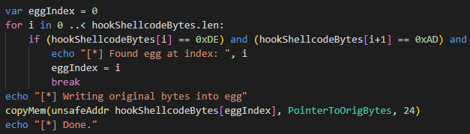
Challenges in the Implementation
X33fcon 2023 – Cat & Mouse – or chess?
Getting back the old NtCreateSection value
On resume, the function is already overwritten
The original NtCreateSection function – however - still needs to be called
One solution:
The host process knows about the original value
Egghunter usage

Slide 26
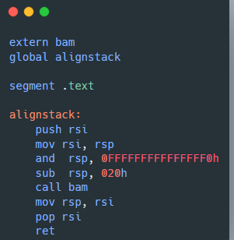
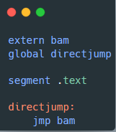
Challenges in the Implementation
X33fcon 2023 – Cat & Mouse – or chess?
Not modifying the NtCreateSection input arguments
We need a direct jmp to our hook function, otherwise the arguments are corrupt
Our stack is already aligned properly
Notes:
The stack is modified on our parameter locations, which leads to corruption

Slide 27
Proof of Concept – Ruy Lopez
05
X33fcon 2023 – Cat & Mouse – or chess?

Slide 28
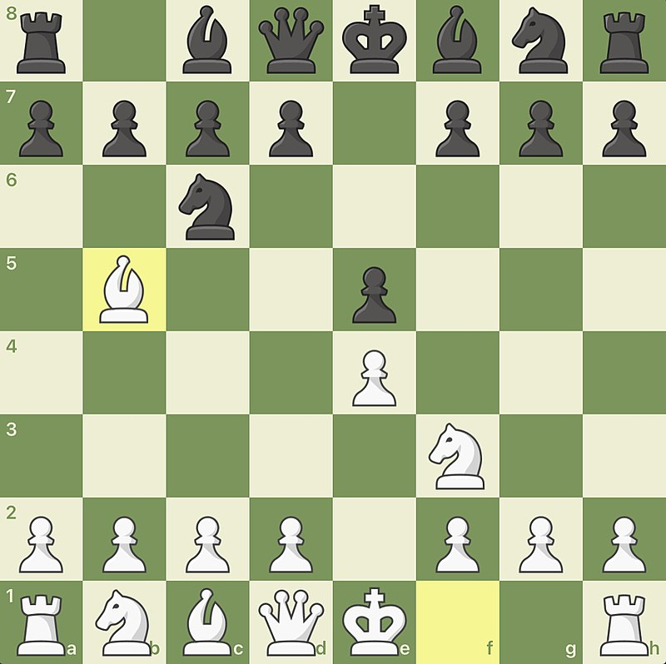
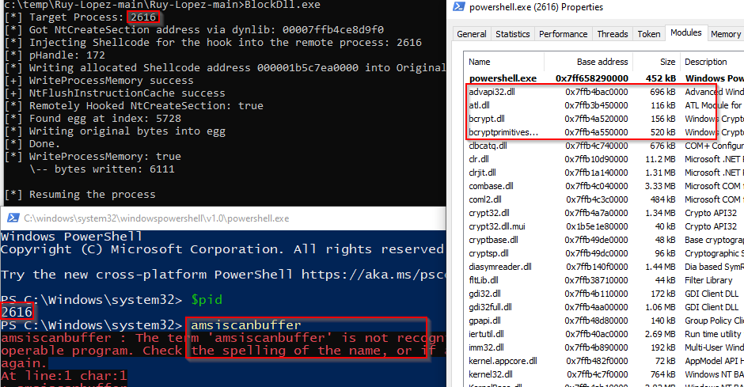
Proof of Concept – Ruy Lopez
X33fcon 2023 – Cat & Mouse – or chess?
https://www.wikidata.org/wiki/Q1290671

Slide 29
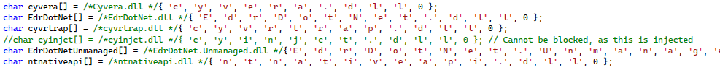
Proof of Concept – Ruy Lopez
X33fcon 2023 – Cat & Mouse – or chess?
Tested against multiple EDR vendors
No Alert/Prevention from any vendor
(Mainly) successful block of target DLLs
Cannot be used against MDE, as there are no userland hooks / DLLs to block
Notes:
Some DLLs are injected
Some vendors dont expect their DLLs not not be loaded. Blocking the DLL can in those cases lead to a crashing process as they still try to interact with it but fail.
With enhancements also blockable -> CreateThread Hook, Entrypoint patch, load an alternative DLL

Slide 30
Proof of Concept – Ruy Lopez
X33fcon 2023 – Cat & Mouse – or chess?
Is that OPSec safe?
Injection + Hooking are easy to detect / have well documented IoCs
Blue Teams / Hunters could easily find IoCs
However, in this moment AV/EDRs don’t check those IoCs for suspended/resumed processes and don’t block it (yet)
Notes:
Some DLLs are injected
Some vendors dont expect their DLLs not not be loaded. Blocking the DLL can in those cases lead to a crashing process as they still try to interact with it but fail.
With enhancements also blockable -> CreateThread Hook, Entrypoint patch, load an alternative DLL

Slide 31
Proof of Concept – Ruy Lopez
X33fcon 2023 – Cat & Mouse – or chess?
OPSec improvements:
Userland Hook evasion for injection from the host process
RX Shellcode (PIC-Code modifications needed)
RX hook memory permissions
Hashing instead of plain DLL names to block
Hardware Breakpoints instead of hooking
Notes:
Some DLLs are injected
Some vendors dont expect their DLLs not not be loaded. Blocking the DLL can in those cases lead to a crashing process as they still try to interact with it but fail.
With enhancements also blockable -> CreateThread Hook, Entrypoint patch, load an alternative DLL
RX Hook permissions (Powershell has some problems with RX and crashes from time to time)

Slide 32
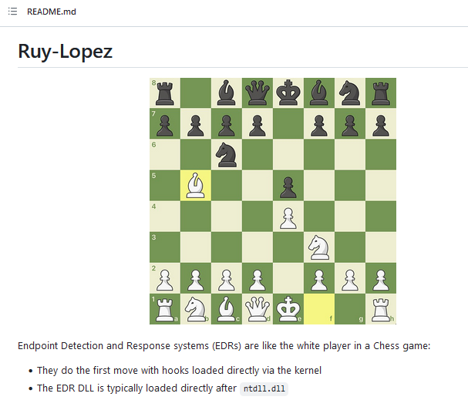
Proof of Concept – Ruy Lopez
X33fcon 2023 – Cat & Mouse – or chess?
https://github.com/S3cur3Th1sSh1t/Ruy-Lopez
Notes:
Some DLLs are injected
Some vendors dont expect their DLLs not not be loaded. Blocking the DLL can in those cases lead to a crashing process as they still try to interact with it but fail.
With enhancements also blockable -> CreateThread Hook, Entrypoint patch, load an alternative DLL

Slide 33
Proof of Concept – Ruy Lopez
X33fcon 2023 – Cat & Mouse – or chess?
Alternative usage ideas:
Wldp.dll block to bypass Device Guard / trust checks
Block custom AMSI Provider DLLs
Inject/Execute shellcode ThreadlessInject1 style in the new process
Note: await Process initialization before execution
(…)
1 https://github.com/CCob/ThreadlessInject
Notes:
Some DLLs are injected
Some vendors dont expect their DLLs not not be loaded. Blocking the DLL can in those cases lead to a crashing process as they still try to interact with it but fail.
With enhancements also blockable -> CreateThread Hook, Entrypoint patch, load an alternative DLL

Slide 34


Proof of Concept – Ruy Lopez
X33fcon 2023 – Cat & Mouse – or chess?
Credits:
Ceri Coburn @_EthicalChaos_
Sven Rath @eversinc33
Alejandro Pinna @frodosobon
Charles Hamilton @MrUn1k0d3r
Chetan Nayak @NinjaParanoid
Notes:
Some DLLs are injected
Some vendors dont expect their DLLs not not be loaded. Blocking the DLL can in those cases lead to a crashing process as they still try to interact with it but fail.
With enhancements also blockable -> CreateThread Hook, Entrypoint patch, load an alternative DLL

Slide 35
Thank you for your attention! QUESTIONS?
Fabian Mosch
Notes:
Some DLLs are injected
Some vendors dont expect their DLLs not not be loaded. Blocking the DLL can in those cases lead to a crashing process as they still try to interact with it but fail.
With enhancements also blockable -> CreateThread Hook, Entrypoint patch, load an alternative DLL

